Slide 1
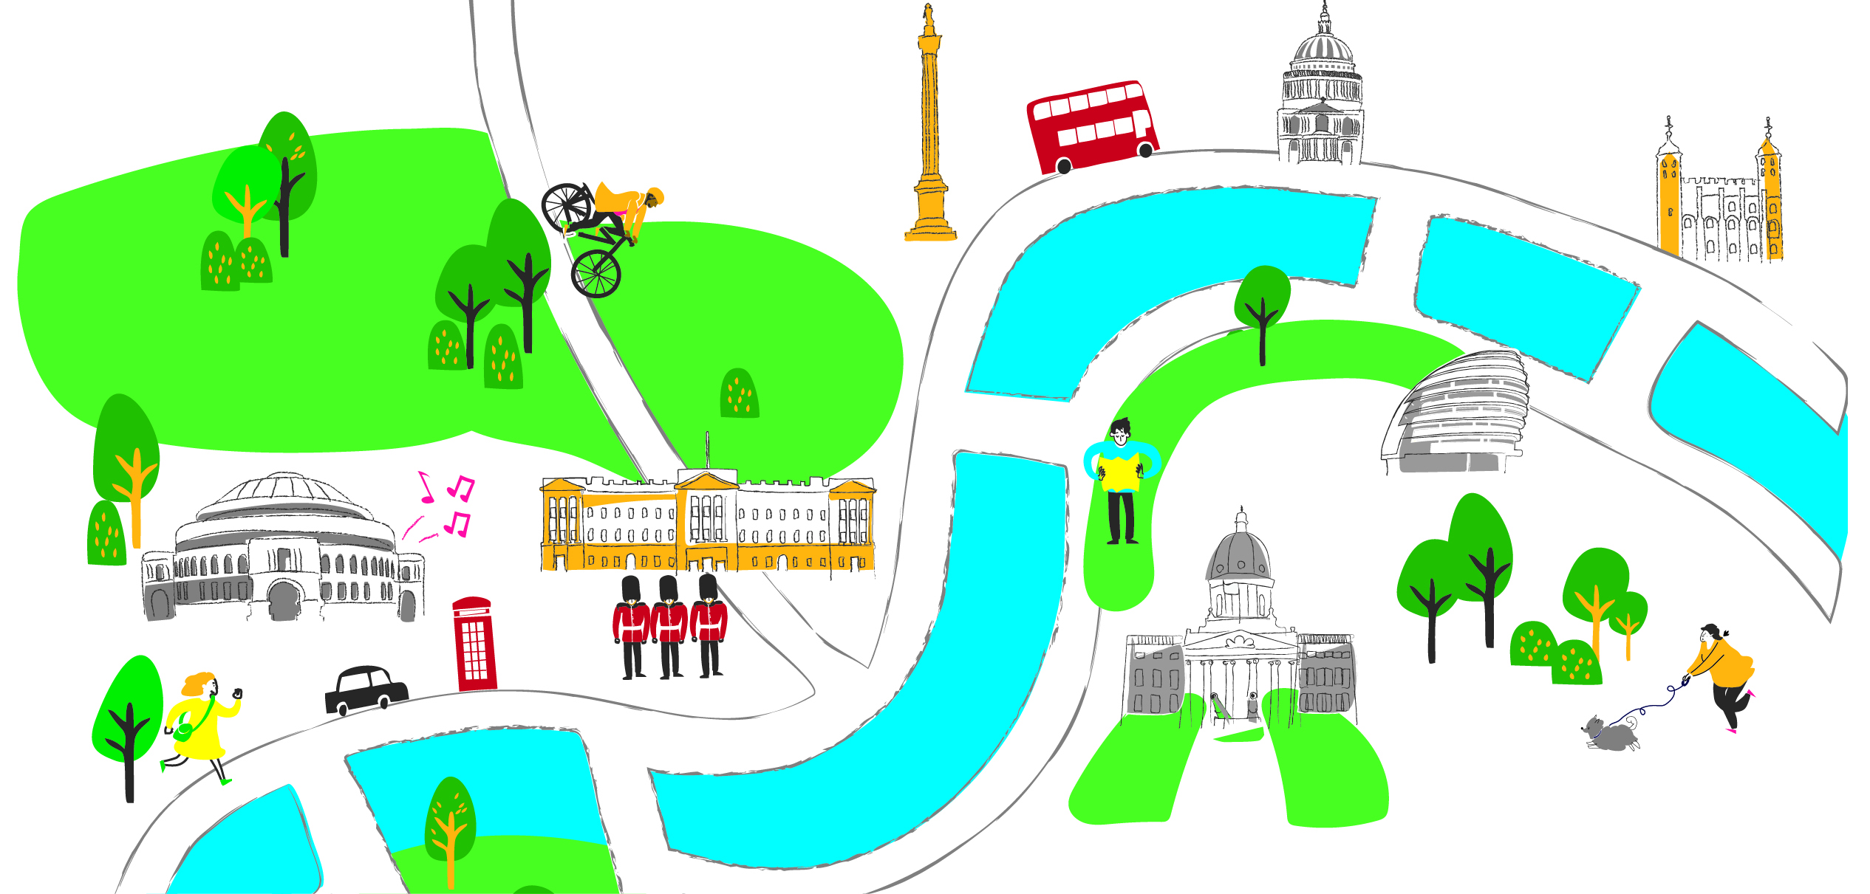

PRIMARY CHALLENGE 2023
COUNT ON US
HEATS: May 2023

Slide 2
Count on Us Primary Challenge 2023
HEATS
Let’s have fun with maths
  Well done for making it to the Heats!
  Let’s have a great time doing maths
  Who goes through to the Final?
    Today’s winning team
    Highest scoring runners up overall

Slide 3
Count on Us Primary Challenge 2023
HEATS
What are we doing?
  3 rounds
    Round 1: Dominoes, Pentominoes,T-Shapes
    Round 2: 24 Game
    Round 3: Code Breaking
  Team and Individual tasks
  Listen carefully to instructions
  Teacher referees: scoring

Slide 4


Round 1: Dominoes, Pentominoes and T-Shapes
  Team activity 20 minutes total
  Part 1: 3 puzzles – 1 of each and then …
  Part 2: Bonus puzzles* –3 of each and then …
  Part 3: Super Bonus puzzles
  * can use up to 3 Exchange Cards

Slide 5

R1: Dominoes, Pentominoes and T-Shapes. Part 1
Part 1:
You must complete all three puzzles before moving onto Bonus puzzles.
Dominoes
6 | 6 | 3 | 3
6 | 6 | 3 | 3
2 | 2 | 2 | 3
2 | 2 | 1 | 1
Pentominoes
Make a 5 x 5 square. Record the pieces (letters) you use.
Make a new 5 x 5 square, with at least one piece changed.
T-Shapes

Slide 6

Round 2: 24® Game

Slide 7
Round 2: 24® Game
Task:
  3 rounds
  3 minutes per round
  Points for claimed cards
  Be confident and ready with last step
  Here’s a reminder of the rules …

Slide 8
Round 2: 24® Game
Claiming a card
  Place hand firmly on card and KEEP it there
  Referee decides who was first
  Announce last step first: 8 x 3 12 x 2 18 + 6 …
  Then lift hand and give full solution
Hesitations, mistakes and stuck…
  Card removed if too slow or a mistake
  Two players can decide to pass – 3 times / round
  If same time, referee decides or removes card

Slide 9
Round 2: 24® Game
Scoring
  Count up points at end of round and record
  Referee checks and signs
Moving around
  A: clockwise, B: stay put, C: anti-clockwise
  1st whistle = start the round
  2nd whistle = stop and score
  (if started claiming, can continue)

Slide 10

BREAK TIME
See you soon

Slide 11
Round 3: Code Breaking A Day Trip
Who are the Elite Codebreakers?
Where are you going on your class day out in London?
What do you need to buy for your trip?

Slide 12
Round 3: Code Breaking A Day Trip
The task: 20 minutes total
Buy 4 items you will need from the pricelist.
£20 budget
Then:
Work out price for all 4 items and your change.
Finally – Bonus:
Work out where you are going.

Slide 13
Round 3: Code Breaking A Day Trip
You will get:
Clues for the items you need
Pricelist
Answer sheet
Then collect:
BONUS: Clue to where you will be going

Slide 14
Round 3: Code Breaking A Day Trip
What do the clue sheets look like?

Slide 15
Code Breaking: Where to meet the Secret Agent
Answer Sheet:
Record the clue and item to buy

Slide 16
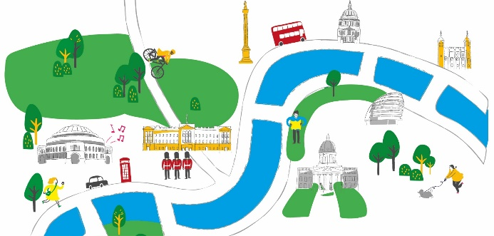
Code Breaking: Where to meet the Secret Agent
Reminder:
4 clues – 4 items
£20 (change?)
Where are you going?
20 mins – teachers give out packs:
Pricelist, Answer Sheet and Clues

Slide 17

HEATS: May 2023
Well done everyone!
What a fantastic time we’ve had doing the
Count on Us Challenge.

